Slide 1


PITSTOP 6 – Service Assurance - QE
Gaurav Rohra

Slide 2
Service Assurance – Quality Engineering
1
3
Achievements
Capability
QE CoE involved in majority of deliverables across CIT, EIT and EP.
Regression Automation across divisions
Delivered various Mission Critical Projects like, NCSOM Upgrade, Provisioning Flow Simplification, Project Fusion, EIPAAS API, Project PCS, Roaming Using Local TimeZone
80%+ FTEs are ISTQB certified
25% + FTEs are certified with advanced certifications relevant to their stream
100% AI Awareness and 5 team members identified for AI training
Leveraging Qmetry Intelligence and Rovo to generate test cases.
2
4
Value Add
Going Forward/ How we align with FY27 Strategy
50% of workforce is cross trained and actively contributing across EIT,CIT and EP.
Onboarded BrowserStack Low-Code Automation for Web Applications.
Implemented Centralized workforce tracking and resource management.
More than 50% applications onboarded on Qmetry.
Health Check implementation is 80% complete across divisions.
Target 90% Regression Automation
FY’27 KPI Alignment with Division
AI based Test Script Generation to accelerate Progressive Automation.
Explore Process Automation like Test Data and Reporting Automation.
Tool Rationalization and Process Harmonization.

Slide 3
AI Driven Log Analytics
AutoBot Automation Tool-Kit
AI Driven Test Script Generation

Slide 4
1. AI Driven Log Analytics
Harsh Bardhan
Tanisha Trivedi

Slide 5




Current State
Manual Log Investigation
Multiple Systems
Knowledge Dependency
Average 80+ P Hrs spent on Log Analysis / Month
Longer Learning Curve

Slide 6
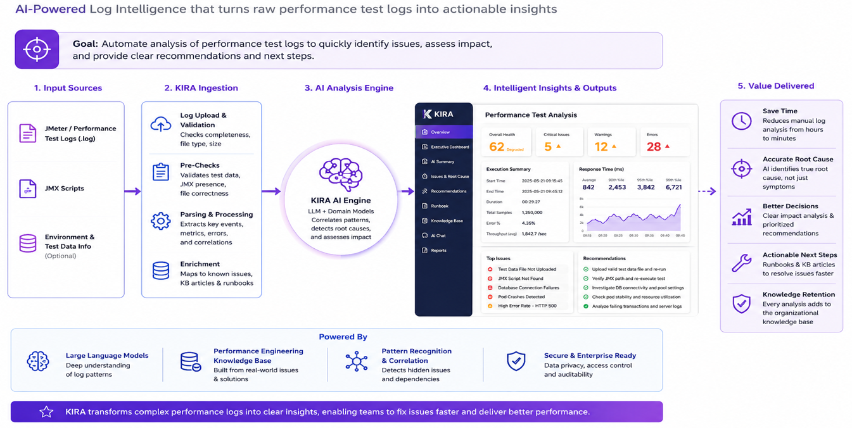
Proposed Solution

Slide 7






Projected Benefits and Key Asks
AI Assisted RCA
Faster Investigation
Knowledge Centralization
Scenario | Effort / Cycle | Projection for 70 Cycles
Manual Analysis | 40-50 MINS | 35+ Hrs
Automated Analysis | 15-18 Mins | 21 Hrs
Standard Recommendations
Future Onboarding
Extensible Platform

Slide 8
2. AutoBot Automation Tool-Kit
Takshashila Tripathi
Theerthaprasad G

Slide 9

Current State
Test Data
Test Data is set up by every tester
Automation scripts used for Test Data Set Up are tightly coupled with scenarios
Average 250+ hrs spent in a month on data set up.
Complex data set up like usage and bill run require file accuracy.
Backend Flows in E2E Automation
Backend jobs and validation executed manually.
Average 250 hrs spent in a month to validate EIT Billing scenarios.
Require understanding of all jobs to test.
Manual report creation.
No End-to-End Automation

Slide 10
Proposed Solution
Bulk Data Creation Platform
Backend Flow Orchestration Tool
console
Input data Ingestion
User Interface
Integration layer
Database
Shell Scripts
API Handler
Usage File Generator
Automation Handler
Backend Jobs
[ECOM, Kenan, AMDD]
ECOM API PT Suite
ECOM UI Automation Suite
Reporting
✓ Self-Service ✓ End-to-End Automation ✓ Automated Reporting​

Slide 11
Projected Benefits
Bulk Data Creation Platform
Metric | Current Process | Tool-Driven Process
Bulk Data creation | Low | High
data flexibility | Low | High
Execution Time | 8-10 minutes/flow | ~5 minutes/flow
Scalability | Low | High
Projection | With 50% of testers setting at least 3-4 test data everyday, projected saving ~100+ P Hrs
Backend Flow Orchestration Tool
Metric | Manual Process | Tool-Driven Process
Execution Time | 15-20 minutes/flow | 8-10 minutes/flow
Reporting and Validations | Manual | Automatic
Scalability | Low | High
Projection | With 5 Core-Apps testers validating at least 10 flows / day projected saving ~100+ P Hrs

Slide 12
3. AI Driven Test Script Generation
Darshan Trivedi
Ritesh Singh

Slide 13
Current State
Current Landscape
Focus on Regression Automation across EIT, CIT, EP
Hybrid teams taking care of Automation and Functional Testing
Web Automation: Serenity BDD + Selenium, Browser Stack
API Testing: REST Assured
Mobile Automation: Appium, Browser Stack
Opportunities
Fragmented Automation Scripts
Flaky Execution & High Maintenance Cost
Longer Test Scripting Effort – Average 4 Hrs / Test Script
Longer Onboarding
Low RoI for Progressive Automation

Slide 14



Proposed Solution
INPUTS
📄API Specs
🏗️ Framework Architecture
🗂️Natural language Prompts
🧠 AI Automation Orchestration
Planner| Generator | Healer
🤖💻 AI-GENERATED TESTS
⚙️ AUTOMATION ENGINE
API | UI | UI+API | Parallel
🌐 UI / API Applications
☁️ API TESTING
Detect API changes
🖥️ UI TESTING
Run right tests
🔄 SHARED TESTING
End to End run
♾️ CI/CD PIPELINE
Continuous Integration
📊 REPORTS & INSIGHTS
Allure Reporting

Slide 15
Projected Benefits
Faster Automation script development
👨‍💻
Reduced manual coding effort
✅
Accelerated automation delivery
📄
Consistent and Standardized code
🚀
Improved QA productivity
Metric | Before AI | With AI
New Script Creation | 3-4 Hours | 1–2 hours
Maintenance Effort | High | Reduced by up to 70% through standardized, reusable,

Slide 16
Disclaimer: This material that follows is a presentation of general background information about Singtel’s activities current at the date of the presentation. The information contained in this document is intended only for use during the presentation and should not be disseminated or distributed to parties outside the presentation. It is information given in summary form and does not purport to be complete. It is not to be relied upon as to advice to investors or potential investors and does not take into Singapore Telecommunications Limited Company registration number: 199201624D.

